Slide 1
Questioning Data
DL Day 2 class

Slide 2
Learning Objectives
By the end of this lesson, you will be able to:
Asking probing questions about data sources, collection methods, biases
Identifying outliers and anomalies that may require further investigation
Techniques for working with large data sets
Differentiating correlation from causation
Criteria for proving causal relationships between variables

Slide 3
Learning Objectives
Mastering these areas will help build good instincts for:
questioning data
drawing out insights
using information judiciously
It aims to foster curiosity and give you tools to determine whether conclusions being drawn from data are valid and evidence-based

Slide 4
Data Analysis
When beginning any data analysis project, it is critical to start by thoroughly evaluating:
Quality
Accuracy
Relevance of the data set
Before drawing conclusions, making projections, or supporting decision-making, one must deeply understand the strengths and limitations of the data.
This due diligence is easy to rush or overlook when anxious for insights, but no analysis can be stronger than the input data itself.

Slide 5
Data Quality
Data Quality refers to the processes and controls in place when data is collected, validated, formatted, and entered/recorded.
Higher quality data has enough context and metadata so anomalies can be explained rather than misleading.
Attributes to evaluate include:
Consistency - Are values uniformly entered over time? Are formats and approaches standardized?
Completeness - Is all collected data making it into the set or are there gaps? Enough background provided?
Accuracy - Does data represent the intended actual values versus estimates or proxies? How are values confirmed?
Dependability - Would same inputs always yield same outputs? Are technology/processes documenting data reliable?

Slide 6
Data Accuracy
Data Accuracy means how close recorded data matches real-world values for what is being measured.
Some key elements include:
Free of bias - Is there any systematic over/under-estimation based on collection approaches?
Statistical confidence - How confident are we values reflect population not just sample?
Precision versus estimates - Does data capture precise measurements or coarse clusters/approximations?
Updates to incorrect data - Are processes in place to improve accuracy over time if wrong?

Slide 7
Data Relevancy
Relevance means data that is applicable and statistically connected to desired analysis outcomes.
Considerations for relevance:
Aligns to analysis goals - Do the metrics clearly map to answering intended questions?
Appropriate level of granularity - Is detail and segmentation appropriate? Too coarse or granular?
Direct or proxy relationship - Is desired output directly observable or inferred/approximated?
Contextualized properly - Is the significance and context of data is meaningful and not misleading?

Slide 8
Summary
Evaluating relevance, accuracy, and quality helps determine whether a dataset can serve as a trustworthy, robust foundation for driving analysis.
Documenting limitations also guides whether additional data is required before conclusions can reasonably be made.

Slide 9
Questioning the Data Source
Questions to ask about data:
Source
Timeliness
Actionability
Filters applied
Presence of outliers/missing data
Scales, ranges, categories

Slide 10
Source
The source is where the raw data comes from and by thoroughly understanding the source, you can identify potential biases, strengths, and shortcomings of the data.
First, you need to determine where the data came from. For example, was it:
From an experiment or academic research study?
If so, review the methodology and parameters of the experiment.
Understand the controls, sample size, properly identifying output variables, confirmation of hypotheses, and the potential for things like reproducibility or randomness issues.
From a database?
If so, look into measuring procedures, updating intervals for data entry, and any incentives for participating institutions to over or under-report metrics.
Review what this data was originally intended to track.

Slide 11
Source
From an industry trade association report?
If so, recognize there is unlikely to be criticism of the underlying industry.
Are findings presented objectively or through a promotional lens?
From a survey?
If so, review survey design and analysis considerations closely.
Was the sample size and diversity large enough and carefully balanced?
Were questions worded to reduce inherent bias?
Reviewing previous versions of the same data set can also help identify anomalies or corrections.
By understanding the origins, incentives, and prior issues related to a data set, you can highlight where additional scrutiny is required during analysis and as conclusions are framed for decision-makers.

Slide 12
Timeliness
Understanding when data was collected is essential because often data has a shelf-life for relevance.
Timeliness addresses whether the info accurately depicts the current or reasonably recent state of what is being analyzed.
There are a few key aspects to inspect:
Recency: Confirm when raw data was collected or the date of the most recent entries.
Data on fast changing phenomena like technology adoption, consumer sentiment, employment rates, etc can shift quickly.
Using data captured more than 1-2 years ago increases the risk of drawing outdated or invalid conclusions. Always check the data age.

Slide 13
Timeliness
Sufficiency: Is there enough up-to-date data captured frequently enough to detect meaningful patterns for the analysis goals?
High frequency time series data often best illuminates trends.
But understand seasonal cycles too - some phenomena play out over quarters, years, even decades. Match data frequency to the cycle being analyzed.
Anchoring: Just because a data set includes some recent data, does not mean it should be trusted fully.
If based mainly on old data, then supplemented only with tiny samples of newer data periodically, it results in outdated anchoring.
Weigh sampling relevance year-over-year before assuming timeliness.

Slide 14
Timeliness
Evaluating timeliness also means comparing to other available data benchmark sources and identifying suspiciously dated or infrequent data capture cycles that could undermine reliability.
Confirming that the timing, frequency, and volume of up-to-date data is sufficient to support the analysis goals is the key to determining true timeliness and relevance. Insufficiently timely data often links to ineffective actions.

Slide 15
Actionability
The key question actionability aims to answer is - can this data be directly applied to inform meaningful decisions and drive real-world outcomes?
The most powerful data sets clearly indicate specific actions that should be taken or provide clear support when choosing between alternative actions.

Slide 16
Actionability
There are two primary lenses to evaluate actionability:
Clarity of Actions:
Does analysis provide clear strategic, tactical or operational guidance?
Can decisions and next steps be made unambiguously based on the data?
Are there clear thresholds or targets indicated that can be acted upon?
Or conversely, warnings that warrant intervening?
Does the data sufficiently reduce uncertainty and provide enough accurately estimated risk levels to support taking action?
Gaps Limiting Actionability:
Is additional context needed before conclusions can be made?
Are there unanswered questions left or additional data required?
Does the analysis point to any constraints that might block actually implementing actions implied?

Slide 17
Actionability
Essentially - evaluate how clearly and directly data can be turned into actions without gaps.
The most powerful data analysis doesn't just reveal patterns - it serves as a catalyst for real change.
Evaluating precisely how actionable insights are provides guidance on just how much can be reliably inferred and executed from a data set.
Lack of clarity into actions either indicates more data needed or acknowledgment of limitations.

Slide 18
Filtering
Evaluating the filters applied to data is critical for ensuring transparency and awareness of how the dataset may have been intentionally or unintentionally shaped.
Key aspects regarding filters:
Exclusions - Were certain time periods, geographies, populations, or other groups excluded? Are there selection biases based on what was omitted?
Sampling - If sampling was applied, were proper randomization and stratification techniques used? Is sample representative?
Smoothings - Were anomalies smoothed or removed to denoise data? How does this impact interpretability?

Slide 19
Filtering
Field Inclusions - Was data limited to certain pre-determined fields or variables versus readily available?
Segmenting - Were parts segmented for standalone analysis that may lose wider context?
Normalization - Were any normalized scales, indexes, per-capita metrics used that may reframe understanding?

Slide 20
Filtering
Evaluating filtering helps determine if all required data is present for full analysis and ensures whatever exclusions were consciously applied are made transparent.
Reconstructing filtering steps allows for reprocessing data differently if initial areas for investigation prove fruitless.
Full transparency on the sequence of included, excluded and transformed data powerfully informs analysis and guards against confirmation biases creeping in

Slide 21
Outliers & Missing Data
Outliers refer to data points that fall statistically outside the norm of the overall distribution.
Key aspects when identifying outliers:
Determine expected distribution and whether points significantly exceed such thresholds based on metrics like standard deviation, quartiles, etc.
Assess different classifications of outliers - are they harmless extreme values, anomalies that reveal errors, or outliers exposing fraudulent activity?
Consider treatment - should benign outliers remain, be capped, or fully removed before analysis?

Slide 22
Outliers & Missing Data
Missing data refers to gaps where expected data values are not present. When evaluating coverage gaps:
Profile frequency and causes - is data randomly missing or related to reporting issues?
Estimate impact - does missingness relate to overall quality concerns or introduce minimal bias?
Account for in analysis - where gaps can't be filled, adjust analytic approach for robustness to missingness or weight filled estimates less.

Slide 23
Outliers & Missing Data
Both outliers and missing data point to potential weaknesses in data collection, sample coverage, or processes.
But they may also illuminate valuable deviations from normal circumstances worth understanding through deeper analysis.
Evaluating where, why, and to what extent data is missing or falls outside expected distributions allows for fully transparent handling based on appropriateness for goals.
This enables tackling whether such anomalies can be meaningfully addressed or need acknowledgment during analysis.
The end result are insights and findings that reliably represent the full, complex picture rather than a conveniently filtered subset.

Slide 24
Scales, Ranges, and Categories
Understanding how quantitative metrics are distributed into ranges for analysis as well as how qualitative phenomena are categorized is essential for properly digesting and contextualizing analysis.
For quantitative data, inspect aspects like:
Units and formats - are appropriate units used (e.g. $, ratios)? Is precision relevant?
Scale sensitivity - do small changes mistakenly seem more meaningful due to scale effects?
Range widths - are value bands wide enough to truly differentiate groups?
Range overlaps - are transition zones clear to prevent double counting?

Slide 25
Scales, Ranges, and Categories
For categorized data, evaluate elements including:
Mutual exclusivity - is each observation assigned to only one group?
Collective exhaustiveness - do categories cover all possibilities?
Boundary rationale - what objective rules used to divide groups?
Balance - are uneven category sizes misleading about differences?
Cultural bias - could exclusions or combine choices introduce bias?

Slide 26
Scales, Ranges, and Categories
Getting ranges and categories wrong means even accurate data can seem to tell flawed stories during analysis.
By evaluating segmentation approaches, blindness spots can be illuminated where data could have supported different conclusions with alternative groupings.
Validating that scales, bands and categories make inherent sense and allow the diversity of the true underlying phenomena to emerge allows the data to guide analysis vs channeling analysis towards confirmation bias.
This helps reveal the fullest explanatory and predictive power hidden within the data.

Slide 27
Correlation
Thoroughly vetting the strengths and limitations of an underlying dataset creates a foundation to then carefully evaluate correlation discoveries that may emerge.
As previously discussed, it is essential we fully understand details of data timeliness, completeness, accuracy, relevance to analysis goals, and any exclusions or filters applied over the raw data.
Once suitable data exists for the analysis target, the next phase shifts to exploratory discovery of correlations.
Correlation analysis can reveal intriguing associations between phenomenon which beg deeper investigation even when the causal mechanisms remain unclear.
But similar rigor applied to questioning data must also frame correlation findings appropriately.

Slide 28
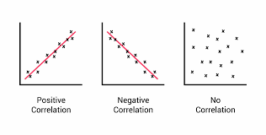
Correlation
Correlation refers to the statistical relationship between two variables.
it can be positive, negative, or lack correlation.
Correlation is about association, not necessarily causation.
Just because two variables are correlated does not definitively mean changes in one cause changes in the other.

Slide 29
Correlation
When identifying correlations during analysis, key questions that should be asked relating to the underlying data include:
Is there enough timely and relevant data sampled to reliably identify correlations?
Correlations can emerge or disappear as more data added.
Could a third confounding variable be driving observed correlation between the two variables?
Does scale, normalization or categorization of data skew identification of correlation strength inaccurately?

Slide 30
Correlation
Evaluating how strongly and reliably data can support claims around correlation relationships is critical.
Effective analysis report correlation with transparency - highlighting relevant strengths as well as clearly articulating assumptions and information still needed to strengthen understanding.
Insights should drive further questioning, rather than prematurely claim fully comprehensive explanations.
Vetting data rigorously enables moving closer to causation claims without overstating implications.

Slide 31
Differentiate between Correlation and Causation
As a reminder, correlation refers to situations where two variables show a statistical relationship, with changes in one variable associated with predictable changes in the other.
However, just because variables are correlated does not definitively mean one causes the other.
For example:
Research may reveal that rates of ice cream consumption are highly correlated with frequent beach attendance.
But consuming ice cream does not cause people to go to the beach, nor does going to the beach causally lead people to eat more ice cream.
The correlation between those variables likely stems from hot sunny summer weather driving both behaviors. This illustrates the risk of confusing correlation with causation.

Slide 32
Differentiate between Correlation and Causation
Validating true causation requires rigorously confirming additional elements beyond correlation to understand the mechanisms linking variables.
This includes: testing time-ordering of changes, ruling out alternate explanatory variables, finding repeated correlations under different conditions, etc.
Therefore when analyzing data, after questioning quality and discovering correlations, it remains essential to transparently articulate what still needs to be investigated further to make any definitive causation claim.
Discovering correlations creates opportunities to unlock deeper insight but only through continued probing of the relationships.

Slide 33
Proving Causation
As stated, causation means variable A directly influences variable B - changes in A actually cause changes in B to occur.
Correlation shows variables moving in relationship but not the mechanisms linking them.
By combining correlation insights with controlled, persistent experiments that evaluate impact sizing, analysis can overtime experimentally demonstrate causative implications.
correlation discoveries still hold significant value for future investigation even if causality remains unproven.

Slide 34
Proving Causation
Proving causation requires meeting more stringent criteria such as:
Strength - the size of effects seen when variable A is changed must have sizable explanatory impact on subsequent shifts in variable B above coincidence levels. Strength of correlations is insufficient. The causal impacts must demonstrate strong effects.
Consistency Over Time - causal relationships should manifest across extended, repeated trials. Temporary or intermittent correlations may stem from confounding factors. True causation remains persistent.
Controlled Experiments - rigorously controlling experiments through inclusion of control groups, placebo samples, randomized trials and emphasis on limiting single explanatory variables allows directly testing causal hypotheses related to variable changes.

Slide 35
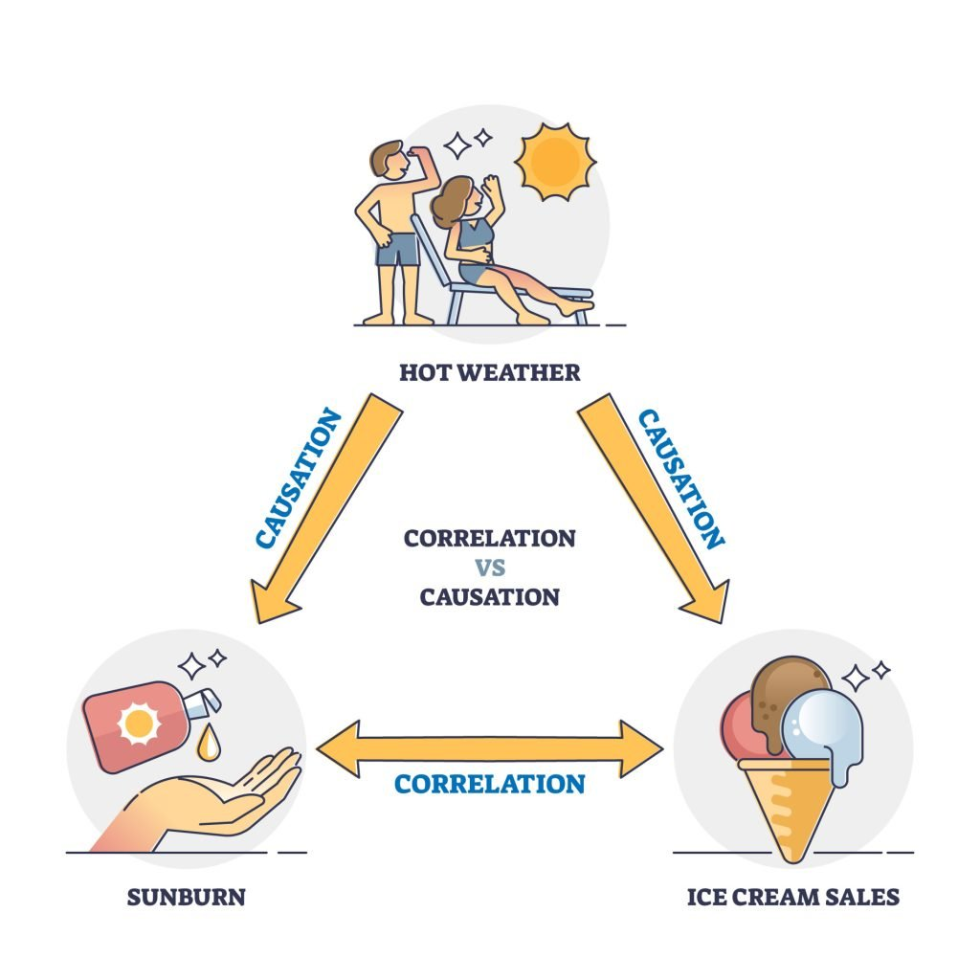
Proving Causation
The way forward when data reveals correlation is hypothesizing potential causation while systematically testing with further analysis - thus transforming speculation into fact.
But confirmation of causation requires going beyond solely the original dataset correlations.

Slide 36
Summary
Key Points
Question the data source, format, filters - understand any weaknesses or bias upfront in the data inputs.
Recognize the difference between correlation and causation - just because two variables are correlated does not definitively mean one causes changes in the other.
Prove causation through controlled experiments - designing rigorous experiments that test hypotheses related to potential causal relationships between variables is required to demonstrate or disprove causation over time.
In essence, conduct thorough due diligence on the quality of data inputs first. Then carefully call out relationships identified as correlational rather than causational. Finally, prove proposed causation through repeated validated experiments rather than assumption.

Slide 37
Exercises
Questioning Data Quality:
Provide sample datasets with embedded issues related to accuracy, completeness, biases, outdated information etc. Have students perform data quality assessments to identify limitations, create transparency on weaknesses, and articulate impacts on reliability.
Correlation vs Causation:
Give pairs of correlated variables (e.g. student grades and hours studied; fitness tracker steps and weight loss). Have students attempt to propose speculative “causal” explanations, then share other potential correlation-only explanations. Emphasizes critical thinking around assumptions.

Slide 38
Exercises
Proving Causation:
Provide hypothetical correlated phenomena (e.g video game time and aggression; diet choices and disease levels). Ask students to design controlled experiment approaches to evaluate potential causal mechanisms linking the sample variables so correlation could become validated causation.
In small groups: Present real-world phenomena with debates around causation claims.
Some examples: social media’s impact on mental health, playing violent video games and crime rates, lockdown mandates, climate change impacts.
Have teams create arguments defending or critiquing the levels of evidence provided around causation based on elements discussed. Exercise emphasizes nuanced evaluation of causation vs simple claims.

